Slide 1

Introduction to Data Analytics
ITE 5201
Lecture4-Data Visualization

Slide 2

Data visualization
Data visualization is the graphical representation of information and data.
By using visual elements like charts, graphs, and maps, data visualization tools provide an accessible way to see and understand trends and patterns in data.
Copyright © 2018 Pearson Education, Inc. All Rights Reserved.

Slide 3
Types of Data Visualization
Data Storytelling
For presentations to organizational decision makers
Data Showcasing
For presentations to analysts, scientist, mathematicians, and engineers
Data Art
For presentations to activists or to the general public
Copyright © 2018 Pearson Education, Inc. All Rights Reserved.

Slide 4
Data Storytelling
Make it easy for the audience to get the point. Your data visualization
should be:
Clutter-free
Highly organized
Audience:
Nonanalysts
Nontechnical business managers
Product types:
Static images
Simple interactive dashboards
Copyright © 2018 Pearson Education, Inc. All Rights Reserved.

Slide 5
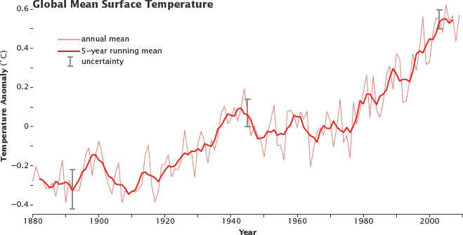
Example
Copyright © 2018 Pearson Education, Inc. All Rights Reserved.

Slide 6
Data Showcasing
Showcase lots of data so your audience members can think for themselves
Your data visualization should be:
Highly contextual
Open ended
Audience:
Analysts
Engineers, mathematicians, scientists
Product types:
Static images
Interactive dashboards
Copyright © 2018 Pearson Education, Inc. All Rights Reserved.

Slide 7
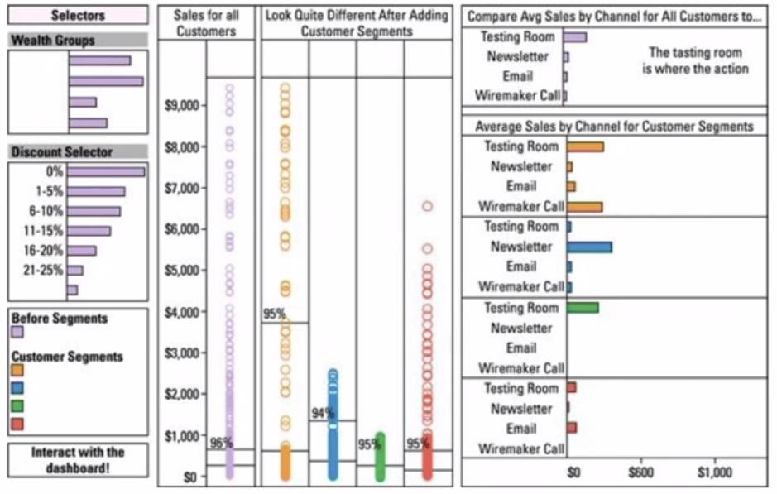
Example
Copyright © 2018 Pearson Education, Inc. All Rights Reserved.

Slide 8
Data Art
Use your data visualization to make a statement
Your data visualization should be:
Attention getting
Creative, controversial
Intended Audience:
Idealists, artists, Social activists
Product types:
Static images
Copyright © 2018 Pearson Education, Inc. All Rights Reserved.

Slide 9
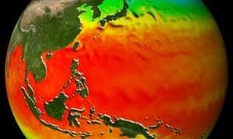
Example
Copyright © 2018 Pearson Education, Inc. All Rights Reserved.

Slide 10
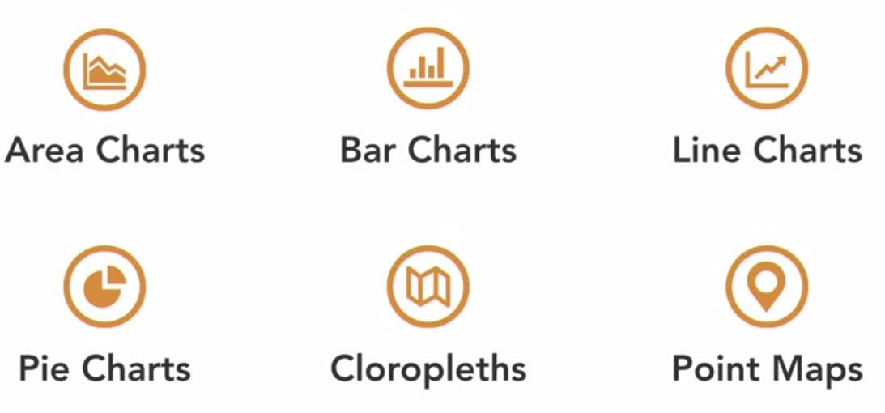
Graphics of data storytelling
Copyright © 2018 Pearson Education, Inc. All Rights Reserved.

Slide 11
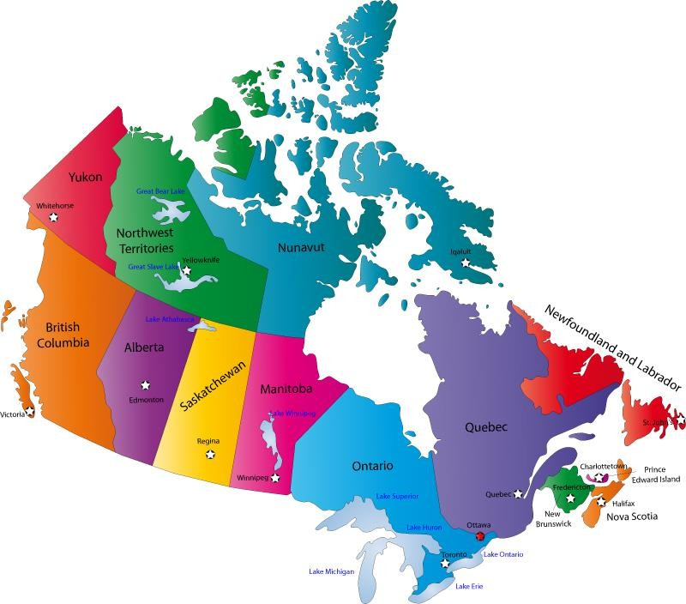
Choropleth map
🞇 A choropleth map displays divided geographical areas or regions that are coloured in relation to a numeric variable.
🞇 First read the instructions and colour legend/key to understand what the shading means.
Copyright © 2018 Pearson Education, Inc. All Rights Reserved.

Slide 12
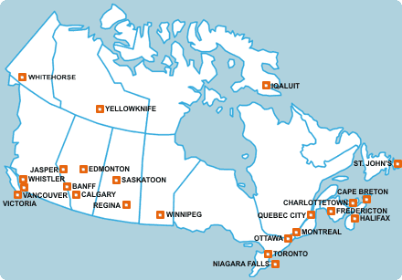
Point map
Copyright © 2018 Pearson Education, Inc. All Rights Reserved.

Slide 13
Steps to choosing data graphics
Make a list of question that your data visualization is meant to answer.
What is your data visualization types?(storytelling, showcasing
or art?
What data graphic type are preferable for the type of data visualization?
Tests out different types of data graphics to see which one is
more meaningful?
Copyright © 2018 Pearson Education, Inc. All Rights Reserved.

Slide 14
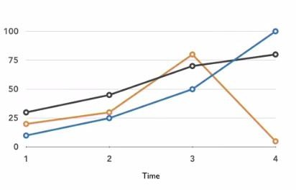
Charts
Line Charts
Show the change in the value of an attribute with respect to an x-variable with is often Time.
Can be use to visually compare the values of several attributes.
Copyright © 2018 Pearson Education, Inc. All Rights Reserved.

Slide 15
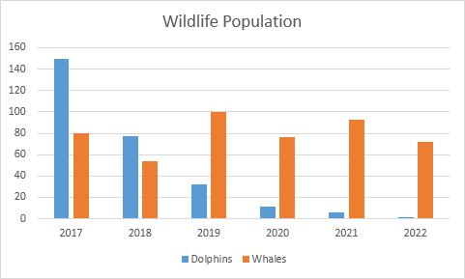
Charts
Bar Charts
Respect data attribute values within a particular data category by using bars of different heights.
Bar Charts represent observation counts within categories.
Copyright © 2018 Pearson Education, Inc. All Rights Reserved.

Slide 16
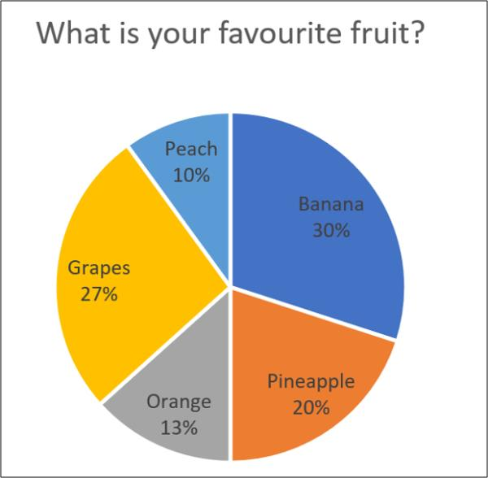
Charts
Pie Chart
A whole and entire set of categorical data is represented by the complete circle and the proportions of observation are presented by slices.
Copyright © 2018 Pearson Education, Inc. All Rights Reserved.

Slide 17
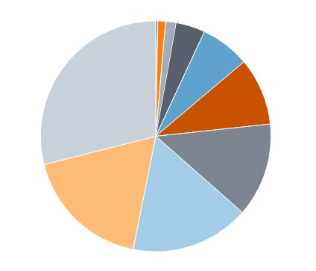
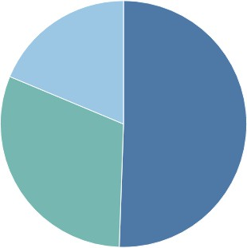
What about pie charts?
Commonly used to show parts of a whole However…
Hard to judge relative size of pie slices – better at differentiating length
Take up a lot of space to present little information
Require labels and good color contrast to even be usable (often difficult)
Best use is when one overwhelmingly larger value than the rest – no need to focus on actual values
Copyright © 2018 Pearson Education, Inc. All Rights Reserved.

Slide 18
Graphs are useful for?
Line graphs can also be used to compare changes over the same
period of time for more than one group.
Pie charts are best to use when you are trying to compare parts of a whole. They do not show changes over time.
Bar graphs are used to compare things between different groups
or to track changes over time.
Copyright © 2018 Pearson Education, Inc. All Rights Reserved.

Slide 19
Data visualization libraries in Python
Matplotlib
Seaborn
Copyright © 2018 Pearson Education, Inc. All Rights Reserved.

Slide 20
Time series
A set of observations, results, or other data obtained over a period
of time, usually at regular intervals:
Monthly sales figures
quarterly inventory data
and daily bank balances are all time series.
A time series plot is a graph that you can use to evaluate patterns and
behavior in data over time.
Copyright © 2018 Pearson Education, Inc. All Rights Reserved.

Slide 21
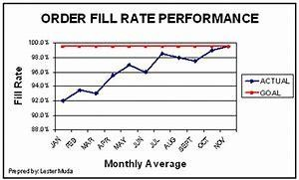
Times series components
Trends: This refers to the movement of a series to relatively
higher or lower values over a long period of time.
For example, when the Time Series Analysis shows a pattern that is upward, we call it an Uptrend,
when the pattern is downward, we call it a Down trend
if there was no trend at all, we call it a horizontal or stationary trend
Copyright © 2018 Pearson Education, Inc. All Rights Reserved.

Slide 22
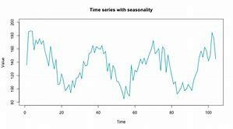
Times series components
Seasonality: This refers to a repeating pattern within a fixed time period.
Trend happens for a period of time and then disappears. However Seasonality keeps happening within a fixed time period.
For example, when it’s Christmas, you discover more candies and chocolates are sold and this keeps happening every year.
Copyright © 2018 Pearson Education, Inc. All Rights Reserved.

Slide 23
Times series components
Irregularity: This is also called noise.
Irregularity happens for a short duration and it’s non depleting.
A very good example is the case of Ebola. During that period, there was a massive demand for hand sanitizers
Copyright © 2018 Pearson Education, Inc. All Rights Reserved.

Slide 24
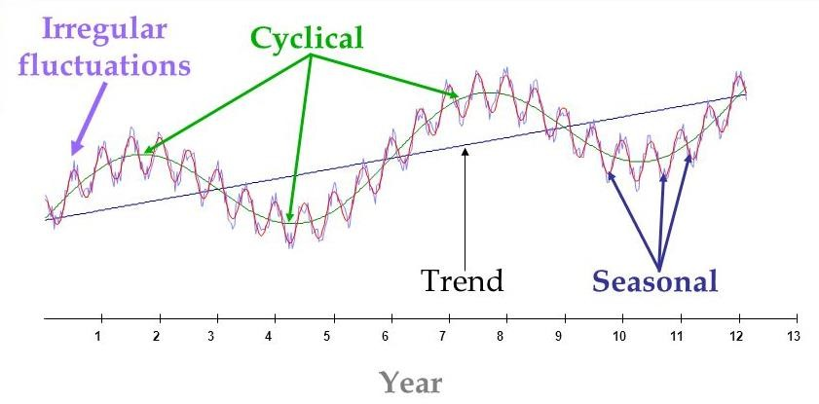
Times series components
Cyclic: This is when a series is repeating upward and downward movement.
It usually does not have a fixed pattern. It could happen in 6months, then two years later, then 4 years, then 1 year later. These kinds of patterns are much harder to predict.
Copyright © 2018 Pearson Education, Inc. All Rights Reserved.

